Slide 1
Today’s Deception Detection Technologies
Russ Warner, VP

Slide 2
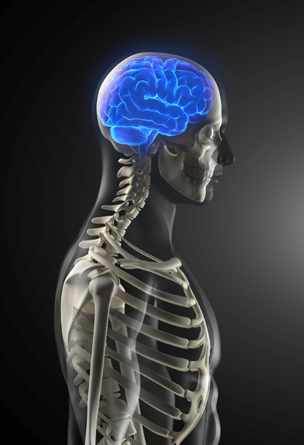
Lying is, in a pure physiological sense, an unnatural act.
- Lewis Thomas
American Physician & Author
President, Memorial Sloan-Kettering Institute
Dean, NYU School of Medicine
Dean, Harvard Medical School
Pulitzer Prize nominee

Slide 3
Agenda
An Overview of Lying
Deception Detection Methods
Traditional Methods
Up-and-Coming Methods
Impact of Corruption/Deception
Q&A
Notes:
We’ll cover these 5 areas in discussing today’s deception detection technologies.

Slide 4
PART 1: Overview of Lying
Lying requires more cognitive effort.
Notes:
Determining deception and credibility are very different issues. At the heart of a lie is the intention to be deceptive.

Slide 5
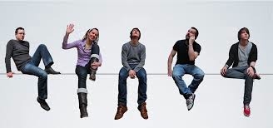
So many ways to lie
Protective – lie to guard the liar from a perceived danger
Heroic – lie to protect others from danger
Playful – lie to enhance a story
Ego – lie to help the liar prevent embarrassment
Gainful – lie to benefit the liar
Malicious – lie to hurt others
Notes:
There are many methods to be deceptive. At the heart of these methods is the intention to be deceptive.
Fabricate – invent information
Falsification – changing facts
Half-truth – mixture of truth and falsehood
Exaggerate – aggrandizement of fact
Mislead – intentional redirection

Slide 6
So many liars
Self-serving - very common
Get something wanted
Pathological – very persuasive
Get something w/o concern for others
Disassociative – departure from reality
Contradict the truth, facts or previous statements
Compulsive - habitual or chronic
The normal way to respond to questions
Notes:
Self-serving liar - very common; get something wanted; examples: Criminal, con artist, politician, sales people
Pathological liar – very persuasive; get something wanted w/o concern for others; manipulative, charming, cunning, self-centered
Compulsive liar – habitual: lying is a habit
Disassociative liar – departure from reality; contradict the truth, facts or previous statements

Slide 7

Physiological Changes
Heart rate
Blood pressure
Respiration
Skin conductance
Pupil dilation
Eye fixation duration
Cognitive load
Voice fluctuation
Question response rate
Emotional arousal
Notes:
Common physiological changes when a subject lies

Slide 8

Test Types
Pre-employment
Periodic
Event-specific
Notes:
Event-specific tests are common for crime investigation, but are administered infrequently.
Pre-employment, as a category, are the most common type of lie detection tests given today.

Slide 9
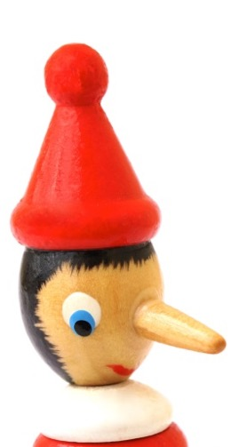
PART 2: Testing Methods
Observation
Integrity Tests
Polygraph
Voice Stress
Brain Scan (EEG, fMRI)
Ocular-motor
Notes:
Lie detection techniques we will discuss today.

Slide 10

Today’s techniques
Subjective
Willing
Likely
Capable
Objective
History
Past Record
Assume the future
Notes:
You can categorize today’s screening and lie detection techniques into two general categories: predict future behavior or identify past behavior.

Slide 11
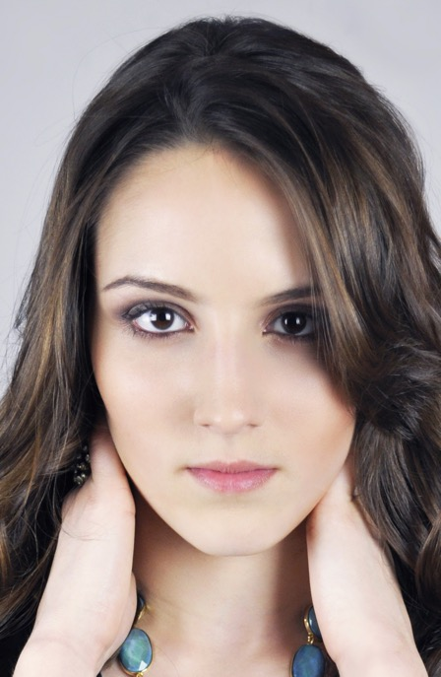
#2 Observation/Interrogation
Behaviors such as gaze aversion, touching the body or face, or covering the eyes or mouth while speaking have not been found to be reliable indicators for deception.
Notes:
Even if you have a field-tested expert, that solution cannot scale.

Slide 12
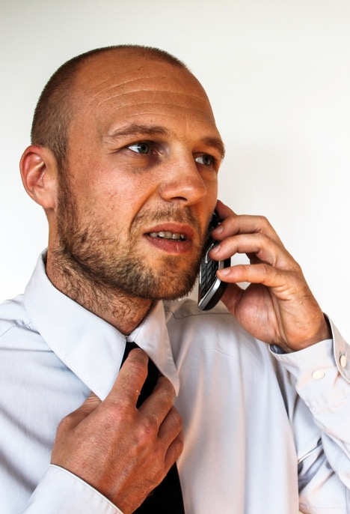
#2 Observation/Interrogation
Despite popular belief, there are no reliable nonverbal deception cues
Accuracy rate of 54%
Source: Bond & DePaulo, 2006
Notes:
Even if you have a field-tested expert, that solution cannot scale.

Slide 13
#3 Personality Tests
Will the candidate do the job?
Is there a job fit from a behavioral perspective?

Slide 14
The Criterion-Related Validity of Integrity Tests: An Updated Meta-Analysis
#3 Integrity Tests
Chad H. Van Iddekinge Florida State University
Philip L. Roth and Patrick H. Raymark Clemson University
Heather N. Odle-Dusseau Gettysburg College
Journal of Applied Psychology 2012

Slide 15
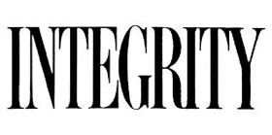
Methodology
Reviewed 104 studies of integrity tests
From test publishers and non-publishers
Calculated validity for predicting:
Job performance
Training performance
Counterproductive work behavior such as substance abuse, theft, withdrawal, etc.
Employee turnover

Slide 16
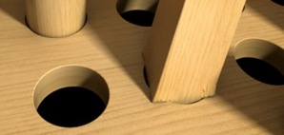
Correlation: Results & Measures
The following are the best-case accuracy figures:
.53 for employee turnover
.55 for job performance
.55 for training performance
.60 for counterproductive work behavior – employee reports (substance abuse, theft, withdrawal, etc.)
.64 for counterproductive work behavior – self report*
Notes:
Correlation between test results and the independent measures of the behavior in question.
The only measure that had a reasonable correlation was self report of counterproductive work behavior (but see contrast with actual employee records).
These results indicate that the tests are very poor predictors.

Slide 17
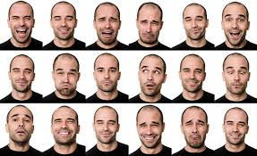
Limitations
Low predictive value for employee behavior
Self report/attitude tests are easily faked
Does not directly assess many disqualifying factors, e.g., criminal relationships, drug abuse, terrorism, criminal activity, financial problems
Extremely difficult to validate for topics that can be assessed by EyeDetect

Slide 18
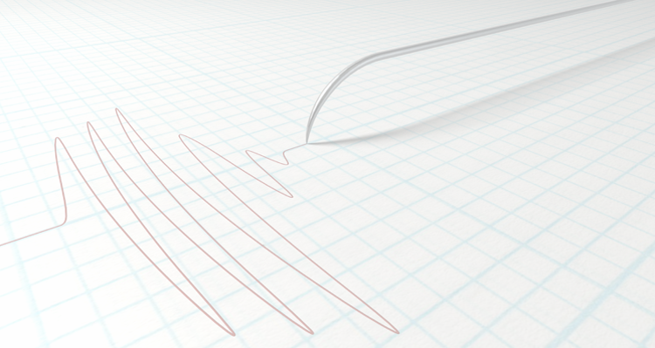
#4 Polygraph
Polygraph - machine in which multiple ("poly") signals from sensors attached to a subject are recorded on a rolled sheet of moving paper ("graph").
Notes:
Developed in the 1920’s & adopted by the FBI in 1939

Slide 19
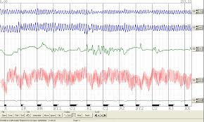
Polygraph Measures
Changes in emotional arousal and cognitive load.

Slide 20
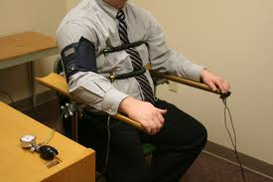
Sensors
Respiration
Pulse
Blood pressure
Skin conductance

Slide 21
Accuracy
Event-specific questioning: 80 - 90%
Pre-employment/periodic: 71% - 82%
APA, 2012, Meta-Analytic Survey of Criterion Accuracy of Validated Polygraph Techniques.
Krapohl, D. J. (2002). The polygraph in personnel screening. In M. Kleiner (Ed.) Handbook of Polygraph Testing. 217-236. San Diego: Academic Press.
Notes:
Event-specific accuracy depends on the examiner

Slide 22
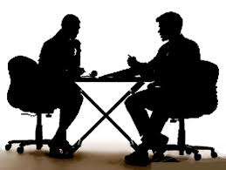
Bias
Interpersonal interactions between examiner and examinee before the test can affect the outcome, as can the interpretation of polygraph recordings.

Slide 23

Acting
Liars, concerned about being believed, often come across as helpful and truthful in an interview, and put more effort into impressing their interviewer.

Slide 24
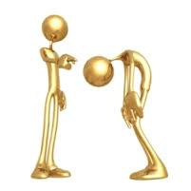
Innocent Appear Guilty
Under stress, many stereotypical behaviors associated with deception are shown:
Speech errors
Fidgeting
Gaze aversion

Slide 25
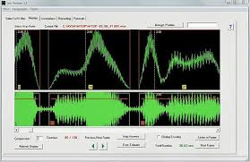
#5 CVSA
Basis for Method
Muscles in the voice box tighten or loosen, which changes the sound of the voice.
Small, involuntary frequency modulations in the voice when under stress (i.e., lying).

Slide 26
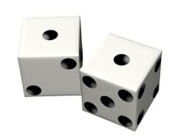
Accuracy
TP rates : 50% to 65%.
FP rate was just as high and often higher.
The CVSA system operates at about chance.
Journal of Forensic Sciences, 53(1), 183-193, Hollien and Harnsberger (2008).

Slide 27
Research
Other sources drawing the same conclusion:
Journal of Forensic Sciences, 53(1), 183-193, Hollien and Harnsberger (2008)
Oklahoma Department of Mental Health and Substance Abuse Services
The Journal of the Acoustical Society of America 124(4):2458, October 2008, Hollien and Harnsberger, “Evaluation of two voice stress analyzers,” J. Acoust. Soc. Am. 124(4):2458, October 2008.
Journal of Forensic Sciences 54(3), 2009, Harnsberger, Hollien, Martin, and K Hollien, “Stress and Deception in Speech: Evaluating Layered Voice Analysis”
National Research Council, Robert Pool, Field Evaluation in the Intelligence and Counterintelligence Context, 2009.
Journal of Forensic Sciences, Hollien et al., “Evaluation of the NITV CVSA,” 2008.

Slide 28
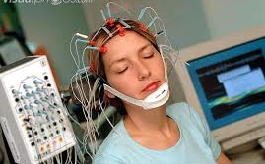
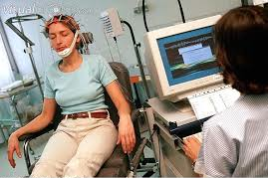
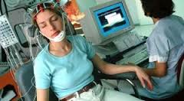
#6 Brain Scan
EEG - electroencephalogram

Slide 29
Measures
Familiar Stimuli - create a positive baseline (i.e., subject sees a friend).
Unfamiliar Stimuli– create a negative baseline (i.e., subject sees a stranger).
Probes - topics on which truthfulness is tested.

Slide 30
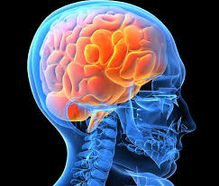
Accuracy
Electroencephalogram
Research shows 87% accuracy.
Biggest challenges:
Too costly and very invasive
Notes:
A number of research papers were published years ago on electroencephalograms that claimed to have achieved results of 87% accuracy (i.e., they could accurately predict if a person was lying 87% of the time) using electrical activity at the surface of the brain

Slide 31
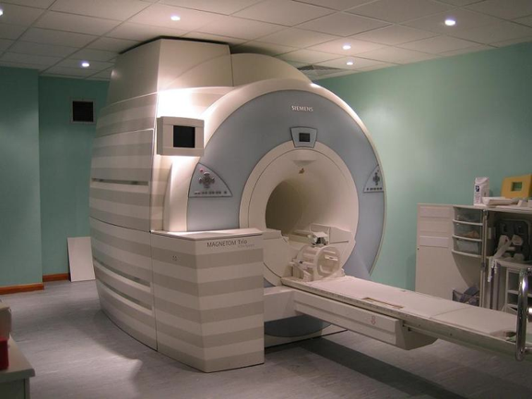
Functional Magnetic Resonance Imaging
fMRI
Real-time
3D models of the body
Notes:
Uses powerful magnets to charge hydrogen protons within cells.
A radio frequency is broadcast by these protons, which absorb the frequency and reflect it back at a receiver.
This information is translated into an image of the area scanned.

Slide 32
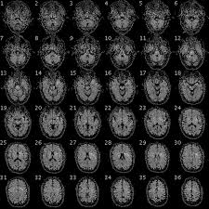
Method
Changes in whole-brain maps of pattern vectors and predicts the cognitive state the brain is experiencing.
Notes:
Creates a map of pattern vectors associated with specific cognitive states.
A radiologist predicts a cognitive state by observing these complex patterns.
The radiologist looks at changes in whole-brain patterns and predicts the cognitive state the brain is experiencing.

Slide 33
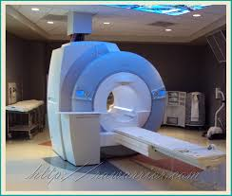
Challenges
Accurate but costly.
Best for pool of subjects, not individuals.
No industry standardization yet.
Not certain if evasive countermeasures can be used.
Notes:
Although it can be highly accurate, it’s costly to administer.
Testing works best when analyzing a pool of subjects, not individuals.
There is no industry standardization yet.
It’s not certain if evasive countermeasures can be used.

Slide 34
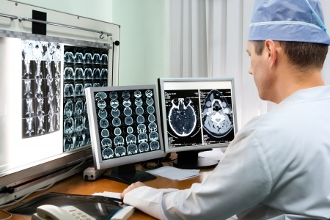
Accuracy
fMRI can be used to predict simple risky behavior at 72% accuracy.
Source: National Academy of Sciences (Feb 2014)

Slide 35
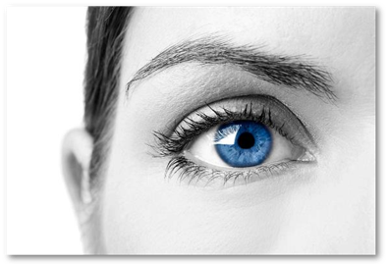
#7 Ocular Motor
Basis for Method
Kircher & Raskin sought for a new method of detecting deception.
Goal to find other physiological test.
The eye exhibits involuntary changes when lying.

Slide 36
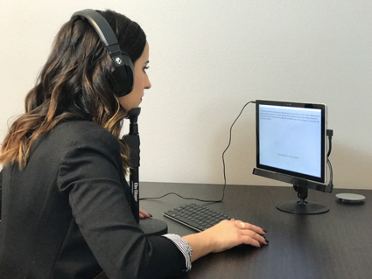
#7 Ocular Motor
Method:
Examinee’s eyes are scanned.
Involuntary changes detected: eye movement, fixation, pupil dilation, and others.
Measures cognitive workload.
Monitors involuntary deception cues.
Source: Journal of Experimental Psychology: Applied
Notes:
Method
Conducted while subject is reading, this test scans the eyes to detect subtle changes in eye movement, pupil dilation, eye fixations, and more.
Measures cognitive workload.
Monitors involuntary deception cues.
Source: Journal of Experimental Psychology: Applied

Slide 37
86% mean accuracy
Pupil Diameter Response*
Guilty Subjects
Innocent Subjects
Tec, 2013
N=200
Relevant Declarations
Secondary Declarations
Neutral Declarations
* just one of various measurements
Notes:
Our Objective: Validate the precision of the EyeDetect technology for the Mexican population.
This study proved EyeDetect was 85% accurate. [EXPLAIN THE 2 CHARTS BRIEFLY]
We anticipate the accuracy rate to be even higher — like in the 90 percentile —when the consequences of detection are greater.

Slide 38

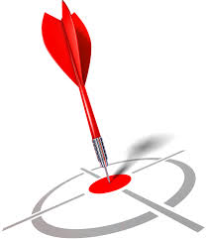
Challenges
Subjects must have proficient reading skills.
Standardized test.
Test design: cultural and local use of vocabulary.
Few relevant issues (but highly accurate).
Notes:
Method
Conducted while subject is reading, this test scans the eyes to detect subtle changes in eye movement, pupil dilation, eye fixations, and more.
Measures cognitive workload.
Monitors involuntary deception cues.
Source: Journal of Experimental Psychology: Applied

Slide 39
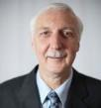




World Class Science Team
Dr. John Kircher
Dr. David Raskin
Dr. Dan Woltz
Dr. Anne Cook
Dr. Doug Hacker
Inventors of the computerized polygraph
World-renowned, widely published experts
8 peer-reviewed studies (more than polygraph)
Notes:
The latest in deception detection technology, ocular-motor deception testing.

Slide 40

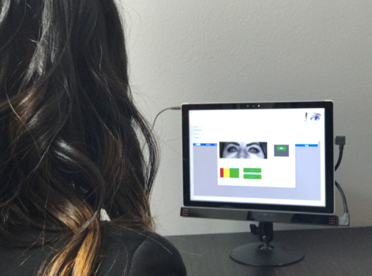





Method
86% accurate
Non-intrusive
30 minute test
Results in 5 minutes
Automated & Consistent
Secure & Incorruptible
Portable
Cost-effective
Trained in 3 hours
Notes:
Sixteen eye characteristics are measured
High-speed optical camera takes 60 photos/second.
Responses to questions are recorded and averaged to improve signal-to-noise ratio.
A complex algorithm is used to correlate and score the changes in eye response to Relevant and Neutral questions.

Slide 41
Comparison of Technologies
Pre-screen/Periodic Test

Slide 42
Thank you!

